Slide 1


Real Time Sign Language
Recognition using Transfer Learning
Domain : Artificial Intelligence and Machine learning
Batch : D2
Guide : Dr. Lipika Goel
Members : Karthik,Sinha,Jashwanth,Anand

Slide 2
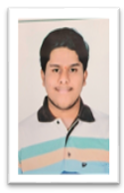
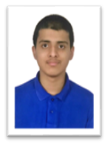
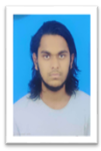
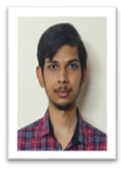
​ | ​ ​ ​ ​ ​ ​ ​ ​ Pavan Karthik​ 19241A05L6​ | ​ ​ ​ ​ ​ ​ ​ ​ Pradyumna Sinha​ 19241A05M0​ ​ | ​ ​ ​ ​ ​ ​ ​ ​ Jashwanth Naidu​ 19241A05J4​ ​ | ​ ​ ​ ​ ​ ​ ​ ​ Anand Thota​ 19241A05M6​ ​
Phone no:​ | 7396771991​ | 9177780311​ | 9390741087​ | 9652990299​
Email:​ | navuluruvspavankarthik@gmail.com​ | pradyumnasinha01@gmail.com​ | jashuwanth2001@gmail.com​ | s.v.k.anand.t@gmail.com​

Slide 3

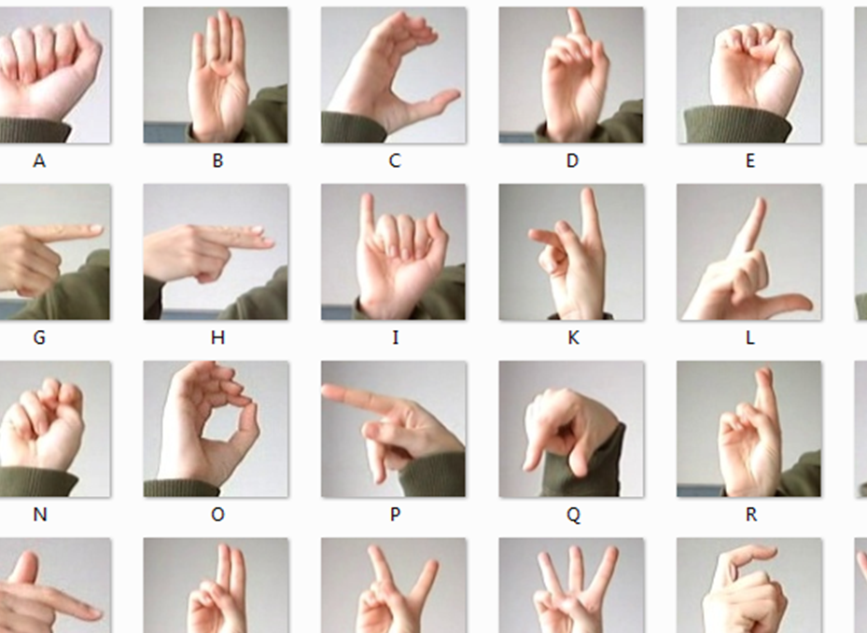
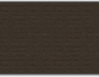
Abstract:
Communication is very crucial to human beings, as it enables us to express ourselves. We communicate through speech, gestures, body language, reading, writing or through visual aids, speech being one of the most commonly used among them. However, unfortunately, for the speaking and hearing-impaired minority, there is a communication gap.

Slide 4
Sign language is learned by deaf and mute and usually it is not known to normal people. It strikes our mind that to bridge the gap between hearing impaired and normal people & make communication easier.
To overcome this barrier, we propose a method where we collect sign language gestures using webcam and by using Transfer learning, we train a Tensor Flow model to create a Real-time Sign Language Recognition system. This will help a lot of people in communicating with deaf and mute people.

Slide 5
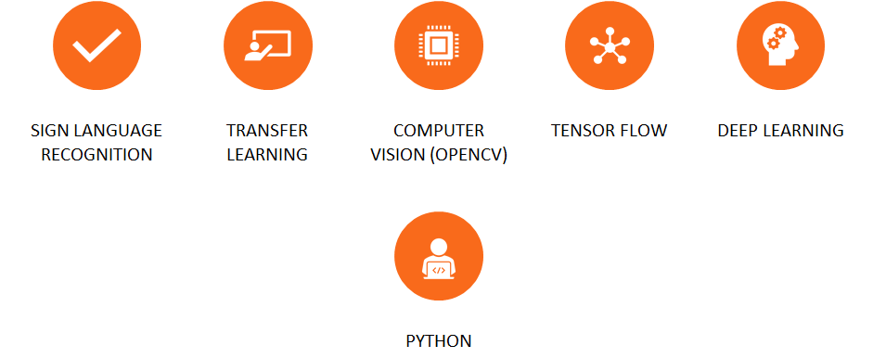

Keywords:

Slide 6


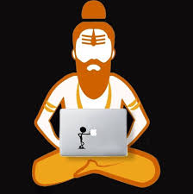
Software Configuration:-
Language : Python
Operating System : Windows 8 or above
IDE : Jupyter notebook
Processor : i3 or above
Hardisk : 500 GB or above
RAM : 2GB or above

Slide 7
EXISTING SYSTEM (VS) PROPOSED SYSTEM
Existing system disadvantages: Highly Expensive .Even if performed by any other ML techniques and With online , they Require tons of images to train for a single gesture .
Proposed system: Hence , We are implementing using a popular Deep Learning technique known as “Transfer Learning” which help us fasten the training process and also require very less number of images for training the model .

Slide 8


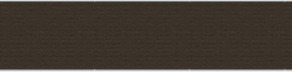
Introduction

Slide 9
Sign languages are one of the means of communication through body movements especially of the hands and arms used when spoken type of communication is not possible. It has become the core form of communication for the communities of deaf and mute people. Hence to overcome this barrier of communication among spoken people and sign language users. We have proposed our model which uses a popular deep learning technique called “Transfer Learning” .
Transfer learning is an approach that involves the usage of acquired knowledge from trained model of a similar type of task and applying it to solve the problem in the related target task.

Slide 10
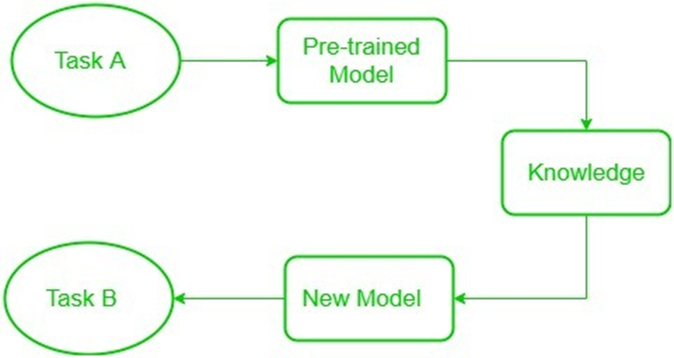

Slide 11
Literature Study

Slide 12
S.No. | Title of the Paper | Author | Journal Details
1 | Creating a custom object detector using Transfer Learning | Joyce Varghese | The startup
2 | Transfer Learning in Sign language | Ali Farhadi David Forsyth Rhyan White | IEEE
3 | Sign Language Recognition System using Transfer Learning Technique | Shivani Y Jarul R Vandana N | Artificial & Computational Intelligence
4 | Transfer Learning for British Sign Language Modelling | Boris Mocialov Graham Turner Helen Hastie | aclanthology.org
5 | A Review Paper on Sign Language Recognition for The Deaf and Dumb | Reddygari Sandhya Rani R Rumana R. Prema | IJERT

Slide 13


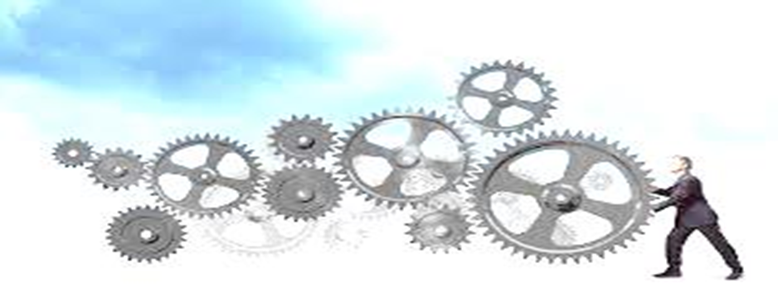
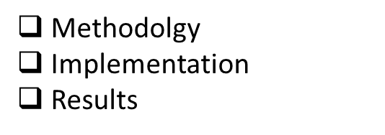
Action Plan

Slide 14
Methodology

Slide 15
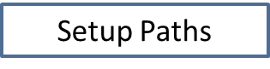

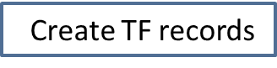
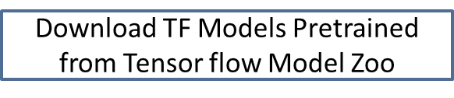
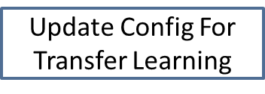
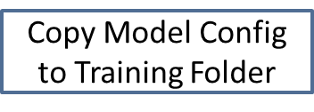
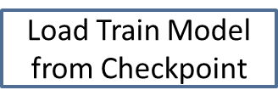
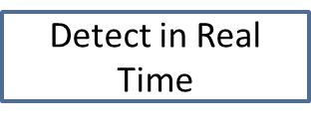


Slide 16


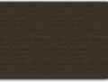
Pre – Installation Requirements:
1. Python
2. Jupyter Notebook
3. Git
4. LabeImg.py interface
5. Tensorflow
6. Tensorflow Object Detection API (Official Tutorial : https://tensorflow-object-detection-api-tutorial.readthedocs.io/en/latest/install.html)
7. Pretrained Model - SDD MobileNet V2 320X320 COCO
8. Visual studio Built tools (available procedure in Tensorflow Object Detection API tutorial)

Slide 17
Implementation

Slide 18
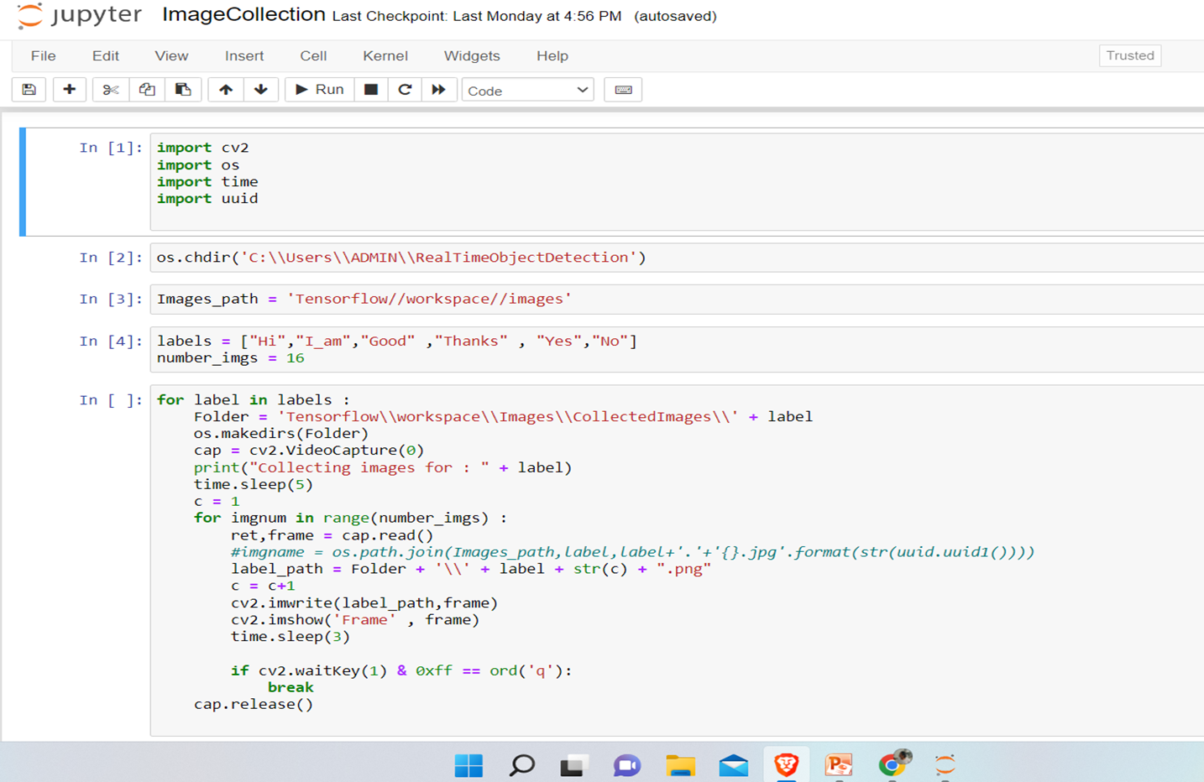

Slide 19
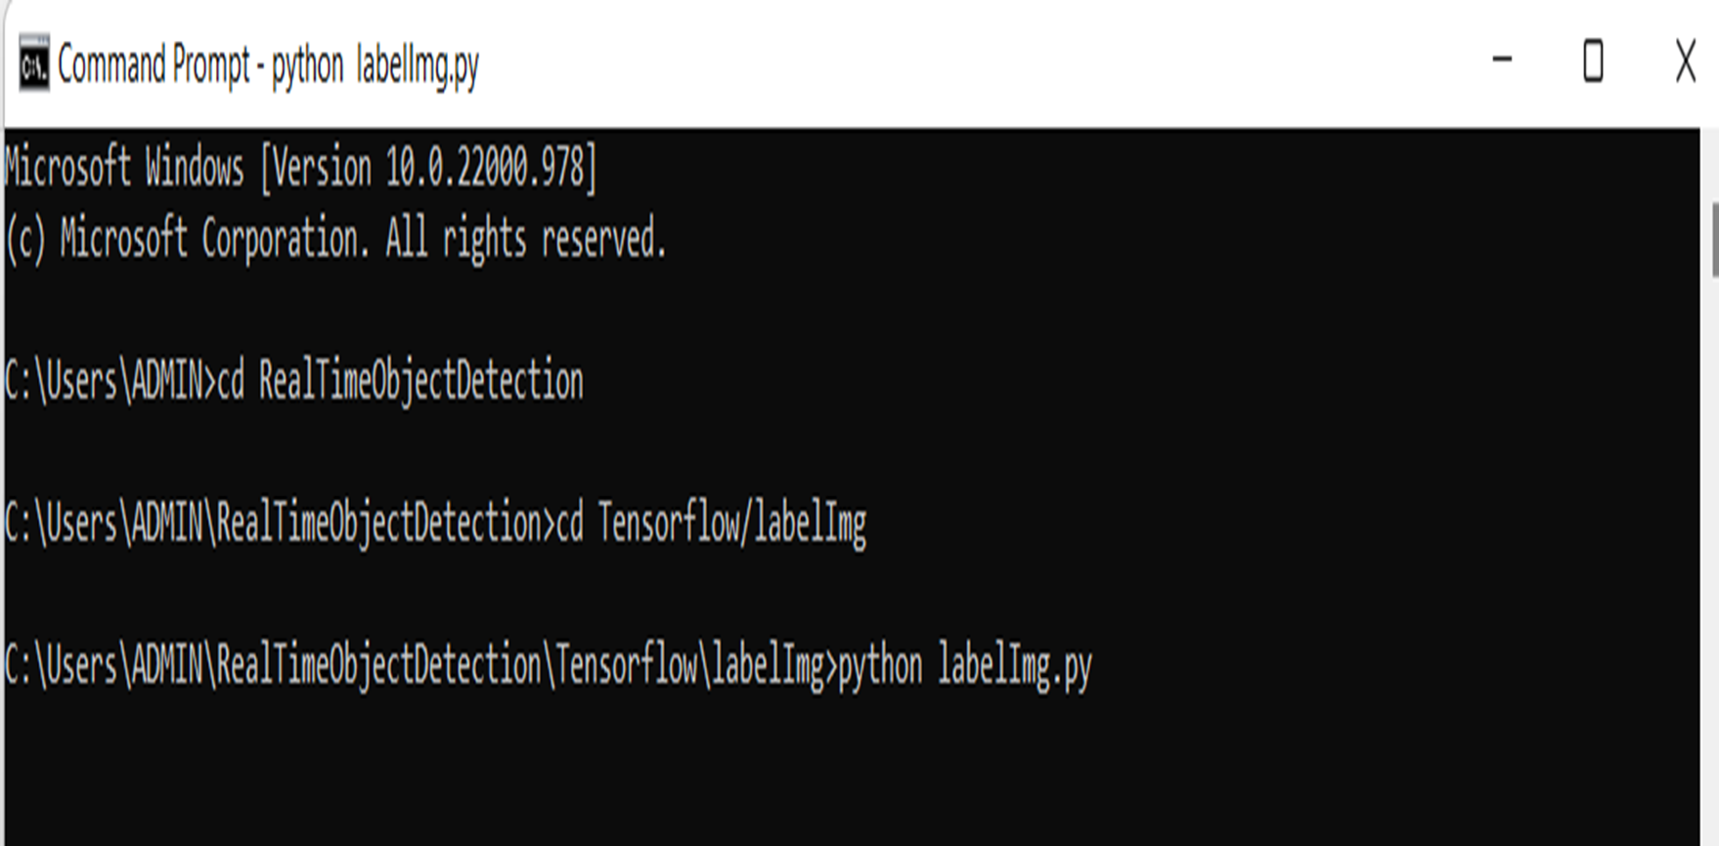

Slide 20
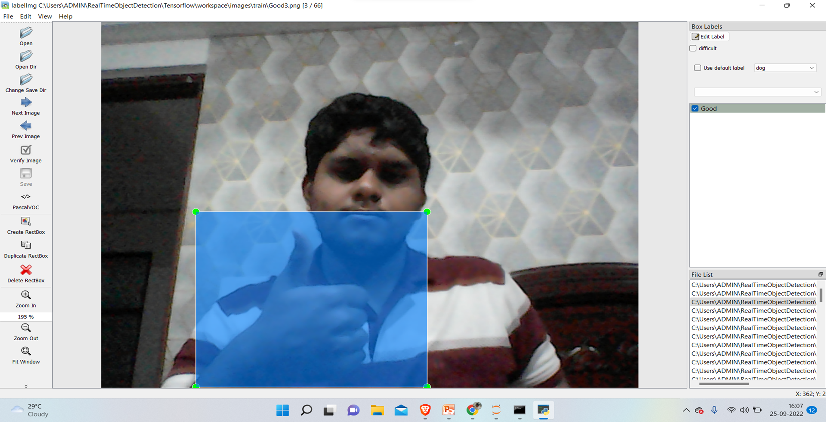

Slide 21
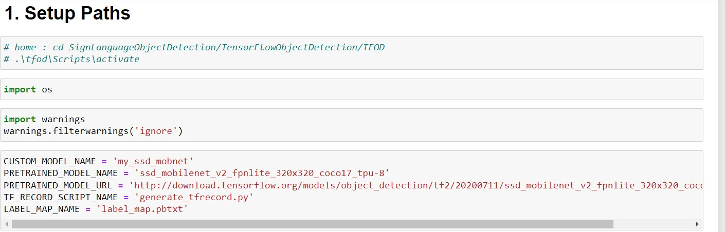

Slide 22
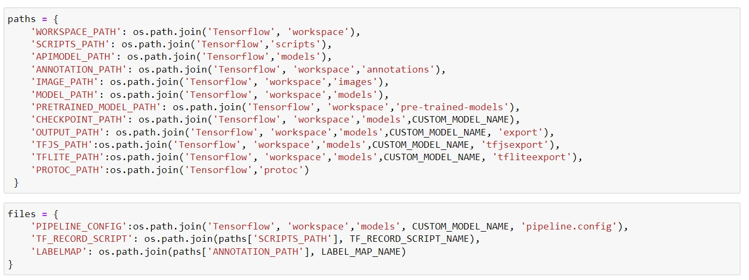

Slide 23
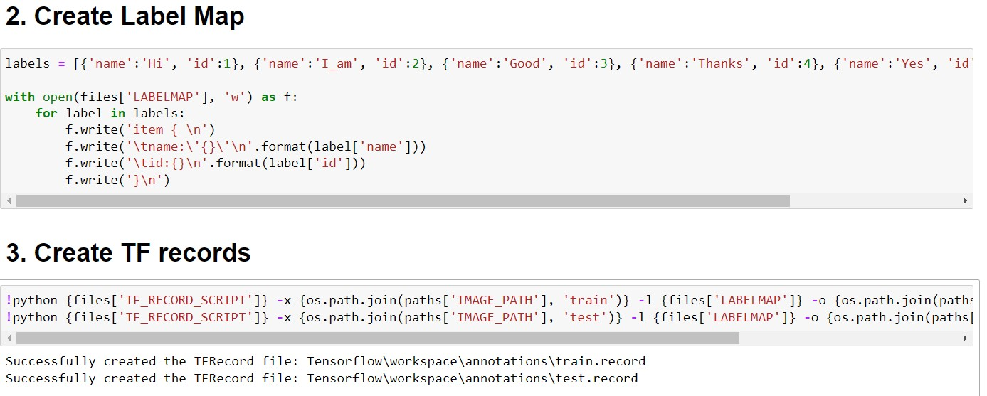

Slide 24
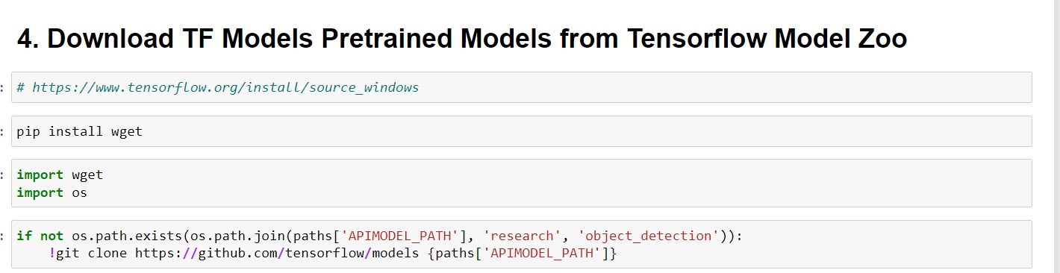

Slide 25
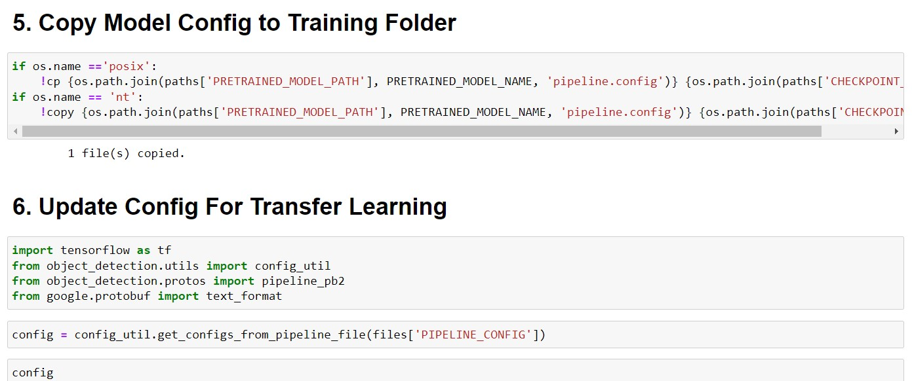

Slide 26
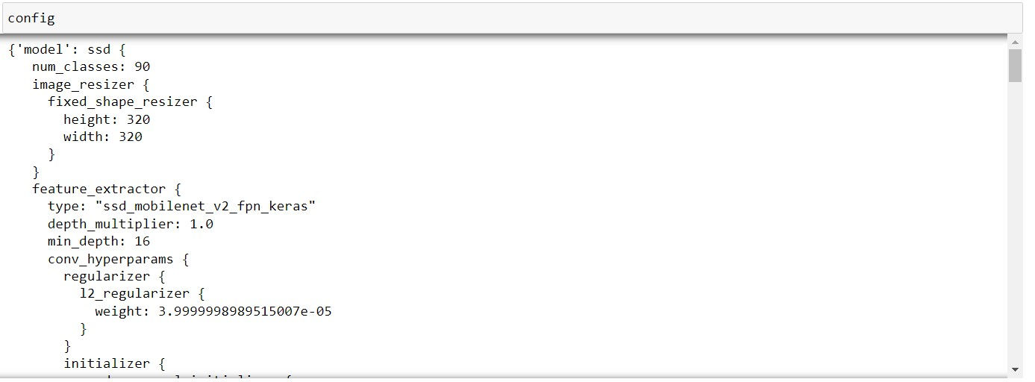

Slide 27
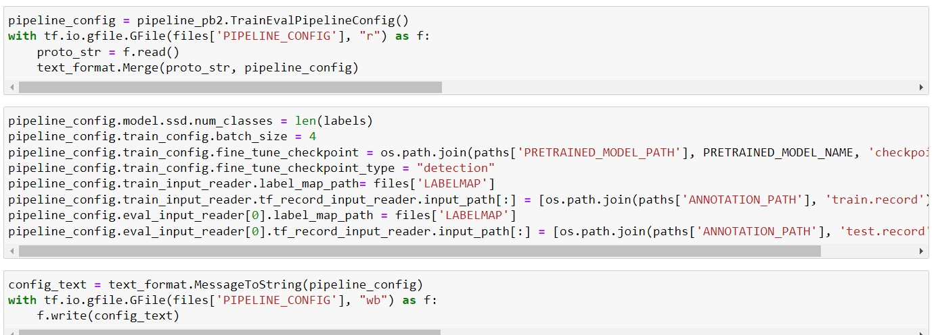

Slide 28
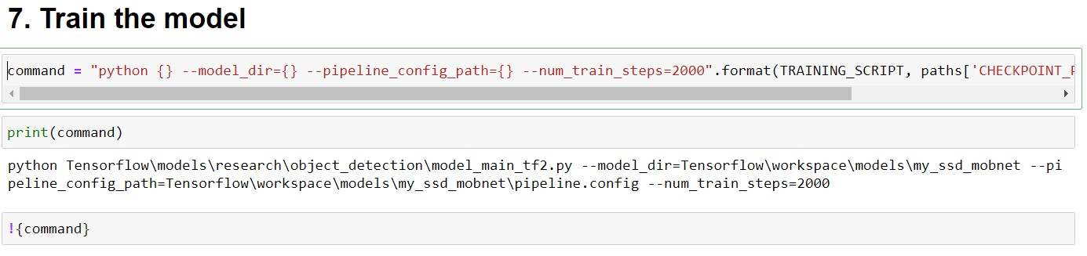

Slide 29
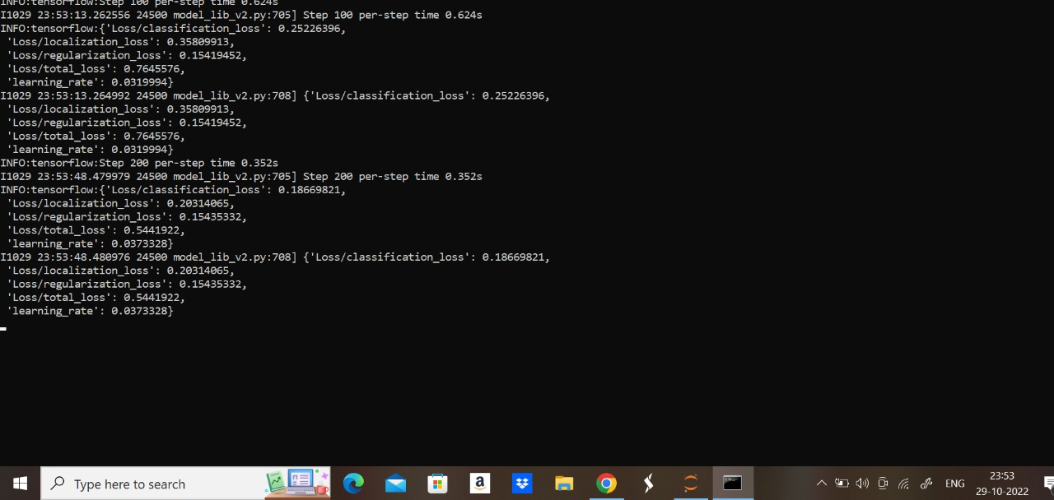

Slide 30
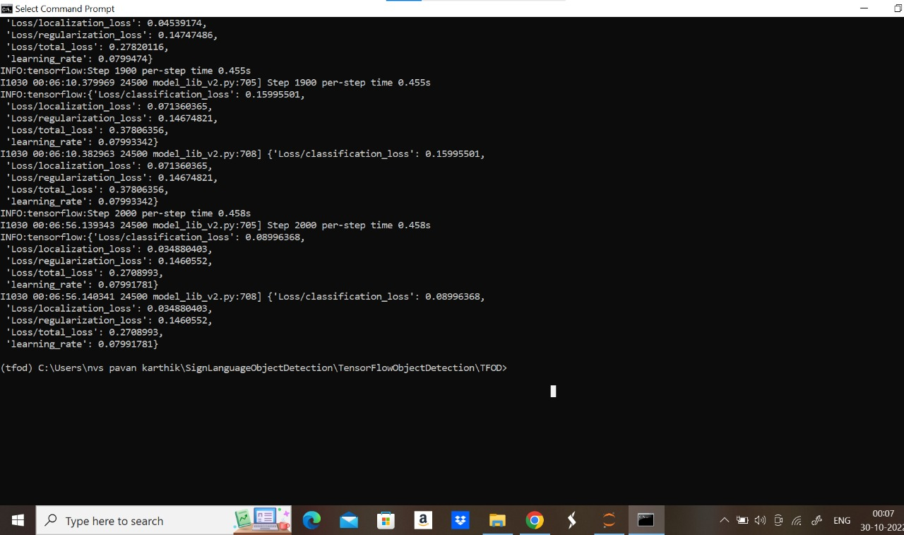

Slide 31
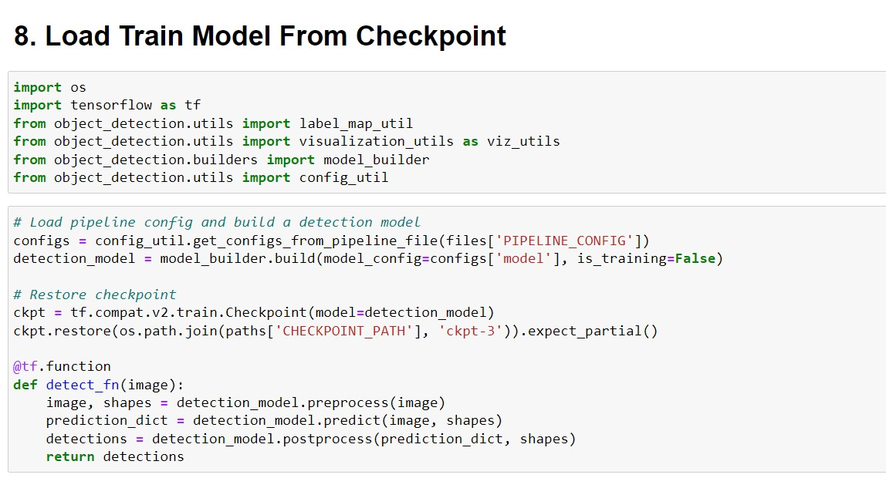

Slide 32
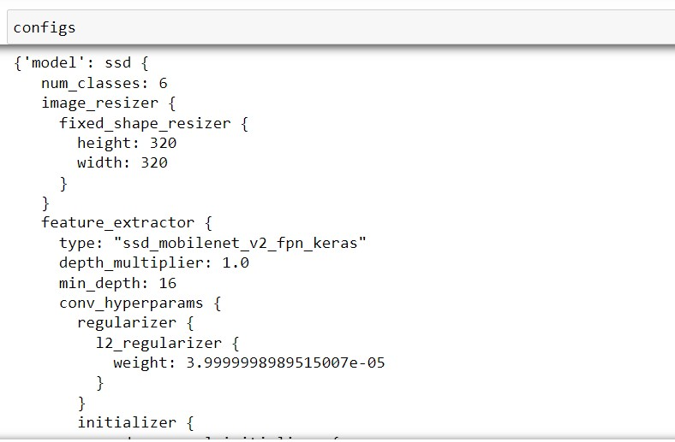

Slide 33
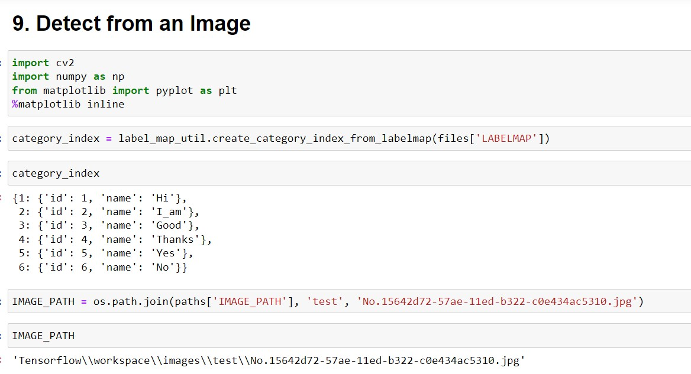

Slide 34
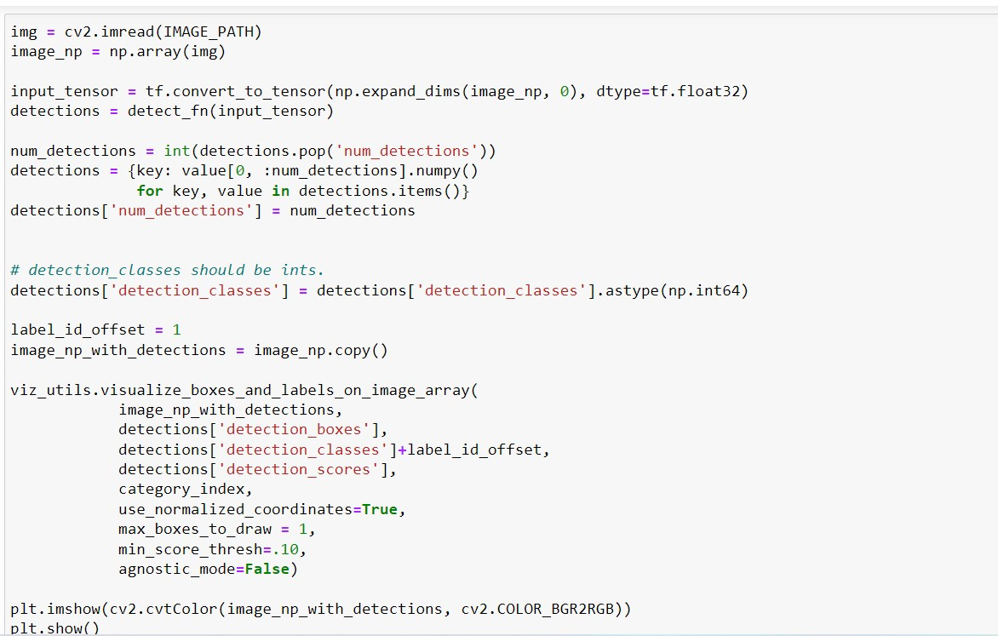

Slide 35
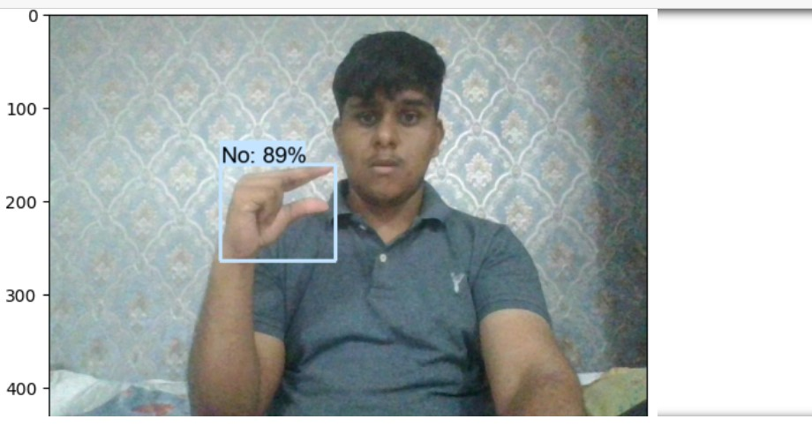

Slide 36
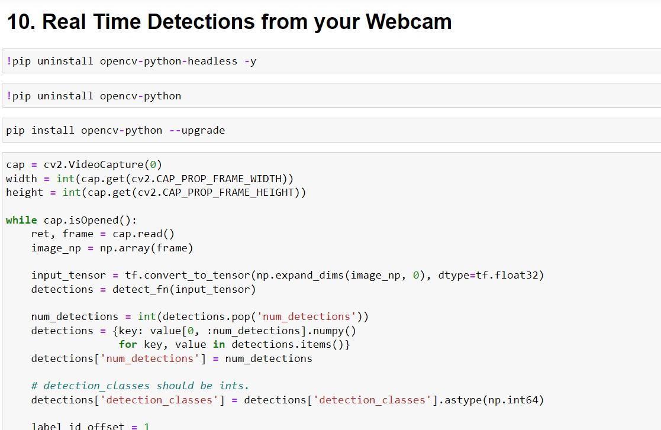

Slide 37
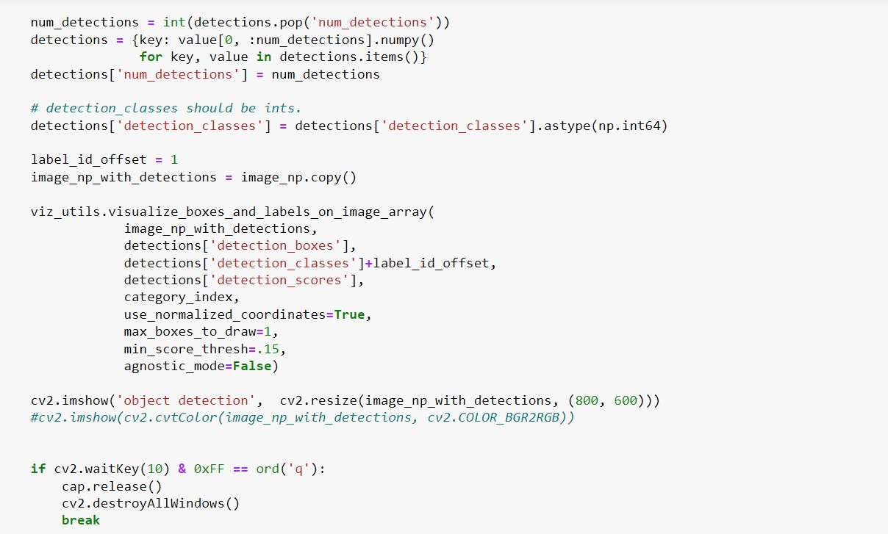

Slide 38

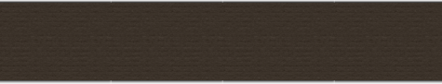
Thank You

